Slide 1
School of Engineering
and
Information Technology
Project Quality Management

Slide 2
Learning Objectives
Understand the importance of project quality management for information technology products and services
Define project quality
Describe quality planning and its relationship to project scope management
Discuss the importance of quality assurance

Slide 3
Learning Objectives
Explain the main outputs of the quality control process
Understand the tools and techniques for quality control
Summarize the contributions of noteworthy quality experts to modern quality management
Discuss how software can assist in project quality management

Slide 4
What Is Project Quality?
The International Organization for Standardization (ISO) defines quality as “the degree to which a set of inherent characteristics fulfils requirements” (ISO9000:2000)
Other experts define quality based on:
  Conformance to requirements: the project’s processes and products meet written specifications
  Fitness for use: a product can be used as it was intended

Slide 5
What Is Project Quality Management?
Project quality management ensures that the project will satisfy the needs for which it was undertaken
Processes include:
  Planning quality: identifying which quality standards are relevant to the project and how to satisfy them; a metric is a standard of measurement
  Performing quality assurance: periodically evaluating overall project performance to ensure the project will satisfy the relevant quality standards
  Performing quality control: monitoring specific project results to ensure that they comply with the relevant quality standards

Slide 6
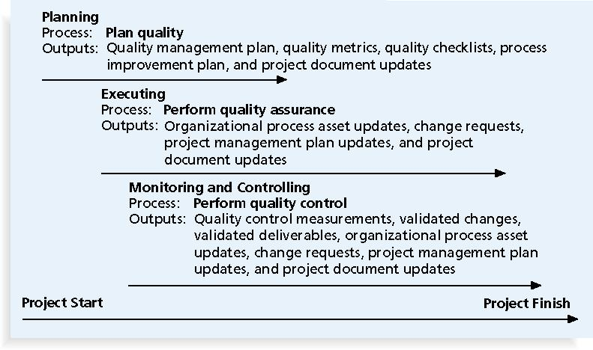
Project Quality Management Summary

Slide 7
Planning Quality
Involves identifying which quality standards are relevant to the project and how to satisfy them
    The application of quality metrics provides a standard of measurement
Main output of this process is the Quality Management Plan

Slide 8
Planning Quality
Implies the ability to anticipate situations and prepare actions to bring about the desired outcome
Important to prevent defects by:
  Selecting proper materials
  Training and indoctrinating people in quality
  Planning a process that ensures the appropriate outcome

Slide 9
Scope Aspects of IT Projects Related to Quality
Functionality: is the degree to which a system performs its intended function
Features: are the system’s special characteristics that appeal to users
System outputs: are the screens and reports the system generates
Performance: addresses how well a product or service performs the customer’s intended use
Reliability: is the ability of a product or service to perform as expected under normal conditions
Maintainability: addresses the ease of performing maintenance on a product

Slide 10
Who is Responsible for the Quality of Projects?
Project managers are ultimately responsible for quality management on their projects
Several organizations and references can help project managers and their teams understand quality
International Organization for Standardization (www.iso.org)
IEEE (www.ieee.org)

Slide 11
Performing Quality Assurance
Quality assurance includes all the activities related to satisfying the relevant quality standards for a project
Benchmarking generates ideas for quality improvements by comparing specific project practices or product characteristics to those of other projects or products within or outside the performing organization
A quality audit is a structured review of specific quality management activities that help identify lessons learned that could improve performance on current or future projects

Slide 12
Quality Control
The main outputs of quality control are:
    Acceptance decisions
    Re-work (if quality is not acceptable or requires updating)
    Process adjustments

Slide 13
Quality Control
There are Seven Basic Tools of Quality that help in performing quality control:
    Cause-and-effect diagrams
    Quality control charts
    Run charts
    Scatter diagrams
    Histograms
      Pareto diagrams
    Scatter diagrams
    Flowcharts

Slide 14
Cause-and-Effect Diagrams
Cause-and-effect diagrams trace complaints about quality problems back to the responsible production operations
  They help find the root cause of a problem
  Also known as fishbone or Ishikawa diagrams
Can also use the 5 whys technique - where you repeatedly ask the question “Why” - to peel away the layers of symptoms that can lead to the root cause

Slide 15
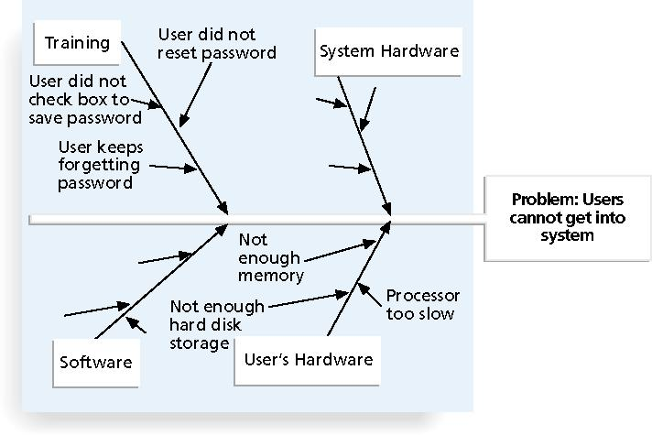
Sample Cause-and-Effect Diagram

Slide 16
Quality Control Charts
A control chart is a graphic display of data that illustrates the results of a process over time
The main use of control charts is to prevent defects, rather than to detect or reject them

Slide 17
Quality Control Charts
Quality control charts allow you to determine whether a process is in control or out of control
    Process is in control: any variations in the results of the process are created by random events; processes that are in control do not need to be adjusted
    Process is out of control: variations in the results of the process are caused by non-random events; there is a need to identify the causes of those events and adjust the process to correct or eliminate them

Slide 18
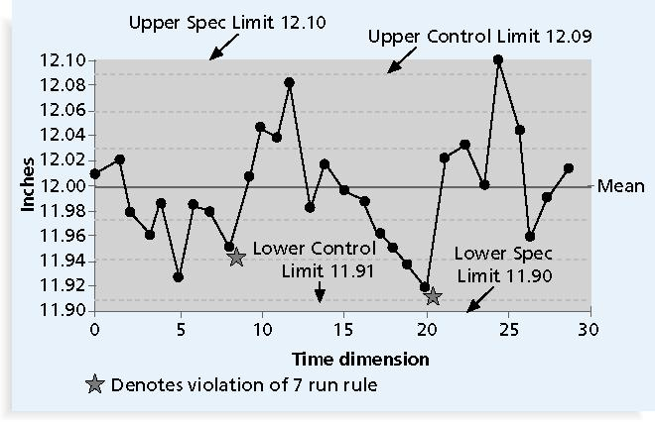
Sample Quality Control Chart

Slide 19
Run Chart
A run chart displays the history and pattern of variation of a process over time
It is a line chart that shows data points plotted in the order in which they occur
Can be used to perform trend analysis to forecast future outcomes based on historical patterns

Slide 20
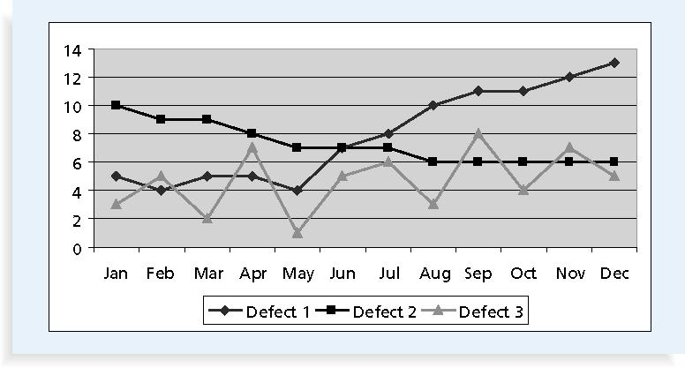
Sample Run Chart

Slide 21
Scatter Diagram
A scatter diagram helps to show if there is a relationship between two variables
The closer data points are to a diagonal line, the more closely the two variables are related

Slide 22
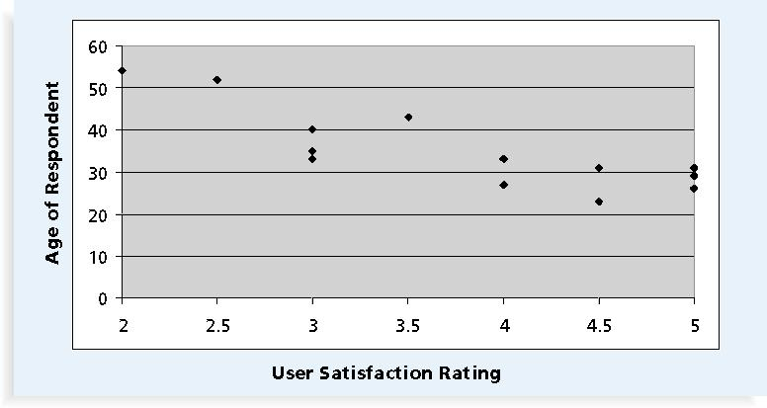
Sample Scatter Diagram

Slide 23
Histograms
A histogram is a bar graph of a distribution of variables
Each bar represents an attribute or characteristic of a problem or situation, and the height of the bar represents its frequency

Slide 24
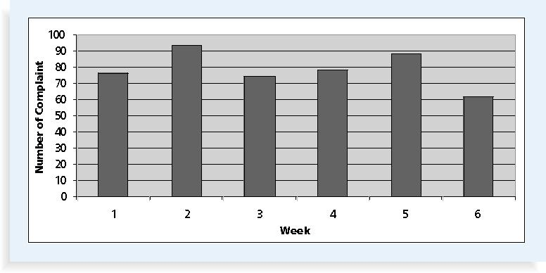
Sample Histogram

Slide 25
Pareto Charts
A Pareto chart is a histogram that can help you identify and prioritize problem areas
Pareto analysis is also called the 80-20 rule, meaning that 80 percent of problems are often due to 20 percent of the causes

Slide 26
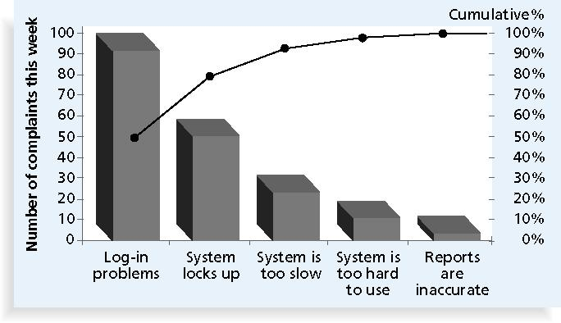
Sample Pareto Chart

Slide 27
Flowcharts
Flowcharts are graphic displays of the logic and flow of processes that help analyze how problems occur and how processes can be improved
They show activities, decision points, and the order of how information is processed

Slide 28
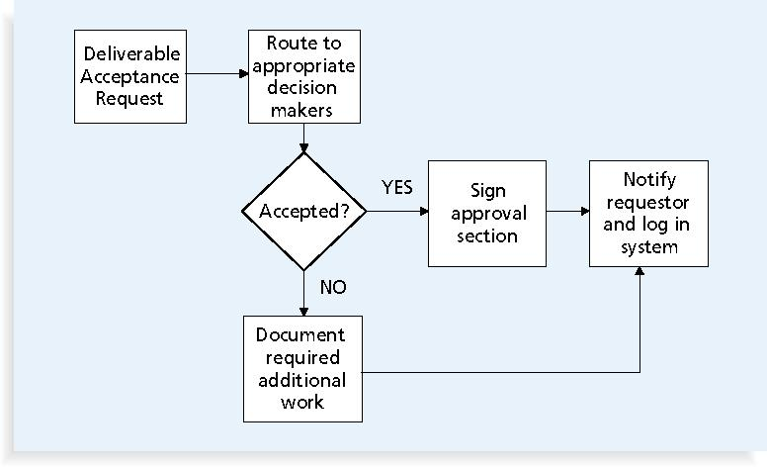
Sample Flowchart

Slide 29
Statistical Sampling
Statistical sampling involves choosing part of a population of interest for inspection
The size of a sample depends on how representative you want the sample to be
Sample size formula:
  Sample size = certainty factor ² x 0.25
  acceptable error
Be sure to consult with an expert when using statistical analysis

Slide 30
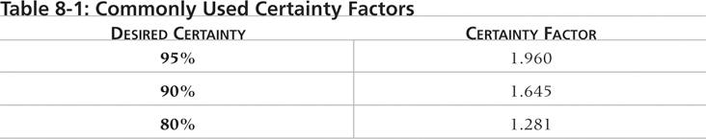
Commonly Used Certainty Factors

Slide 31
Six 9s of Quality
Six 9s of quality is a measure of quality control equal to 1 fault in 1 million opportunities
In the telecommunications industry, it means 99.9999% service availability or 30 seconds of down time per year
This level of quality has also been stated as the target goal for the number of errors in a communications circuit, system failures, or errors in lines of code

Slide 32
Testing
Many IT professionals think of testing as a stage that comes near the end of IT product development
Testing should be done during almost every phase of the IT product development life cycle

Slide 33
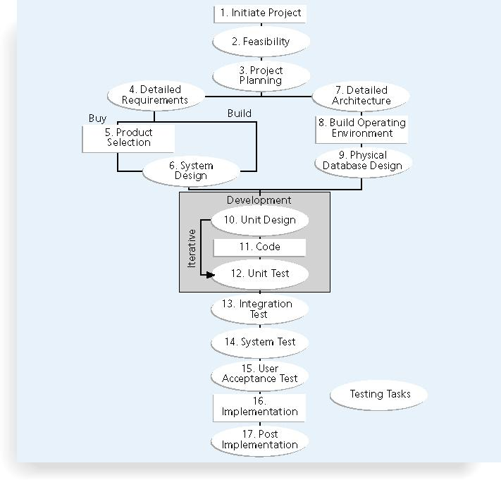
Testing Tasks in the Software Development Life Cycle

Slide 34
Types of Tests
Unit testing tests each individual component (often a program) to ensure it is as defect-free as possible
Integration testing occurs between unit and system testing to test the functionally of grouped components
System testing tests the entire system as one entity
User acceptance testing is an independent test performed by end users prior to accepting the delivered system

Slide 35
Modern Quality Management
Requires customer satisfaction
Prefers prevention to inspection
Recognizes management responsibility for quality
Noteworthy quality experts include Deming, Juran, Crosby, Ishikawa, Taguchi, and Feigenbaum

Slide 36
Quality Experts
Deming was famous for his work in rebuilding Japan and his 14 Points for Management
Juran wrote the Quality Control Handbook and ten steps to quality improvement
Crosby wrote Quality is Free and suggested that organizations strive for zero defects
Ishikawa developed the concepts of quality circles and fishbone diagrams
Taguchi developed methods for optimizing the process of engineering experimentation
Feigenbaum developed the concept of total quality control

Slide 37
ISO Standards
ISO 9000 is a quality system standard that:
    Is a three-part, continuous cycle of planning, controlling, and documenting quality in an organization
    Provides minimum requirements needed for an organization to meet its quality certification standards
    Helps organizations around the world reduce costs and improve customer satisfaction
See www.iso.org for more information

Slide 38
Improving Information Technology Project Quality
Suggestions for improving quality for IT projects include:
    Establish leadership that promotes quality
    Understand the cost of quality
    Focus on organizational influences and workplace factors that affect quality
    Follow maturity models
These are covered in the following slides

Slide 39
Leadership
As Joseph M. Juran said in 1945, “It is most important that top management be quality-minded. In the absence of sincere manifestation of interest at the top, little will happen below.”*
A large percentage of quality problems are associated with management, not technical issues
  *American Society for Quality (ASQ), (www.asqc.org/about/history/juran.html)

Slide 40
The Cost of Quality
The cost of quality is the cost of conformance plus the cost of non-conformance
    Conformance means delivering products that meet requirements and fitness for use
    Non-conformance means not meeting quality expectations or taking responsibility for failures
A study reported that software bugs cost the U.S. economy $59.6 billion each year and that one third of the bugs could be eliminated by an improved testing infrastructure

Slide 41
Quality Cost Categories
Prevention cost: cost of planning and executing a project so it is error-free or within an acceptable error range
Appraisal cost: cost of evaluating processes and their outputs to ensure quality
Internal failure cost: cost incurred to correct an identified defect before the customer receives the product
External failure cost: cost that relates to all errors that are not detected and corrected, before delivery to the customer
Measurement and test equipment costs: capital cost of equipment used to perform prevention and appraisal activities

Slide 42
Organizational Influences, Workplace Factors, and Quality
Study by DeMarco and Lister showed that organizational issues had a much greater influence on programmer productivity than the technical environment or programming languages
Programmer productivity varied by a factor of one to ten across organizations, but only by 21 percent within the same organization
Study found no correlation between productivity and programming language, years of experience, or salary
A dedicated workspace and a quiet work environment were key factors to improving programmer productivity

Slide 43
Expectations and Cultural Differences in Quality
Project managers must understand and manage stakeholder expectations
Expectations also vary by:
    An organization’s culture
    Geographic regions

Slide 44
Maturity Models
Maturity models are frameworks for helping organizations improve their processes and systems
    The Software Quality Function Deployment Model focuses on defining user requirements and planning software projects
    The Software Engineering Institute’s Capability Maturity Model Integration (CMMI) is a process improvement approach that provides organizations with the essential elements of effective processes

Slide 45
CMMI Levels
CMMI levels, from lowest to highest, are:
    Incomplete
    Performed
    Managed
    Defined
    Quantitatively Managed
    Optimized
Companies may not get to bid on government projects unless they have a CMMI Level 3

Slide 46
PMI’s Maturity Model
PMI released the Organizational Project Management Maturity Model (OPM3) in December 2003
Model is based on market research surveys sent to more than 30,000 project management professionals and incorporates 180 best practices and more than 2,400 capabilities, outcomes, and key performance indicators
Addresses standards for excellence in project, program, and portfolio management best practices and explains the capabilities necessary to achieve those best practices

Slide 47
Best Practice
OPM3 provides the following example to illustrate a best practice, capability, outcome, and key performance indicator:
    Best practice: establish internal project management communities
    Capability: facilitate project management activities
    Outcome: local initiatives, meaning the organization develops pockets of consensus around areas of special interest
    Key performance indicator: community addresses local issues

Slide 48
Using Software to Assist in Project Quality Management
Spreadsheet and charting software helps create Pareto diagrams, fishbone diagrams …
Statistical software packages help perform statistical analysis
Specialized software products help manage Six Sigma projects or create quality control charts
Project management software helps create Gantt charts and other tools to help plan and track work related to quality management

Slide 49
Summary
Project quality management ensures that the project will satisfy the needs for which it was undertaken
Main processes include:
    Plan quality
    Perform quality assurance
    Perform quality control

